Slide 1
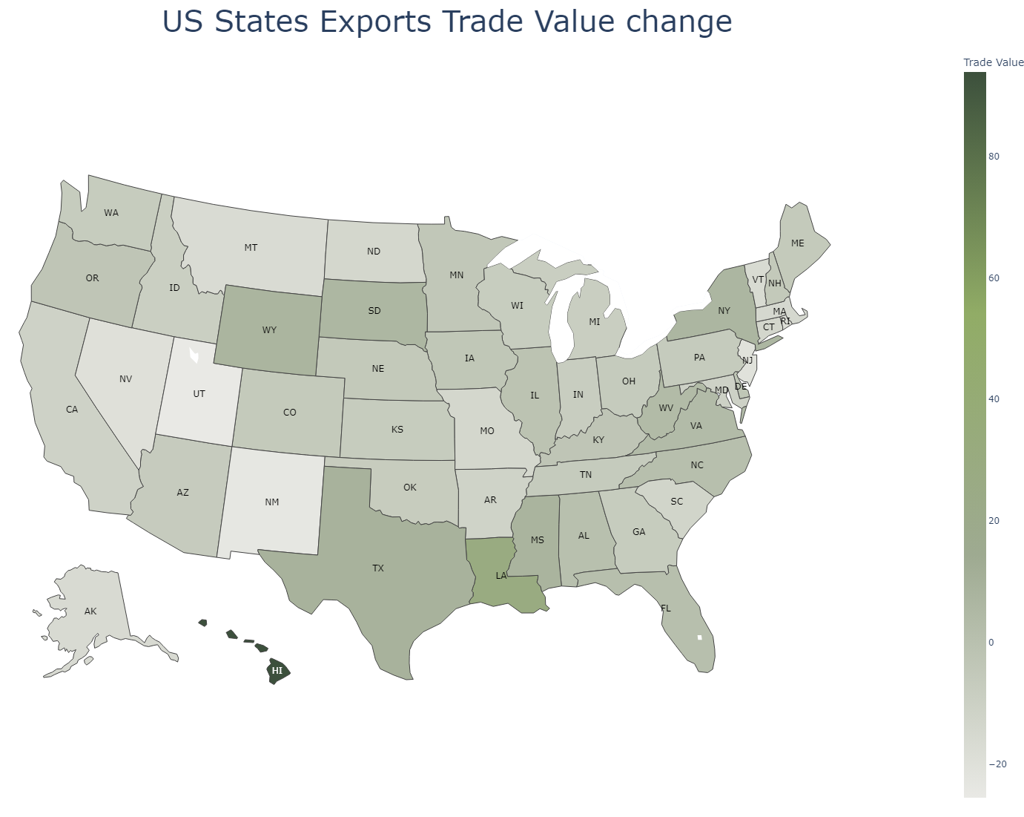
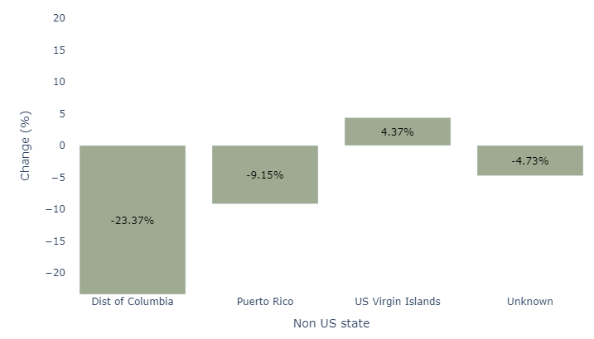
How does the total export and import change by different State from 2021-2022?

Slide 2
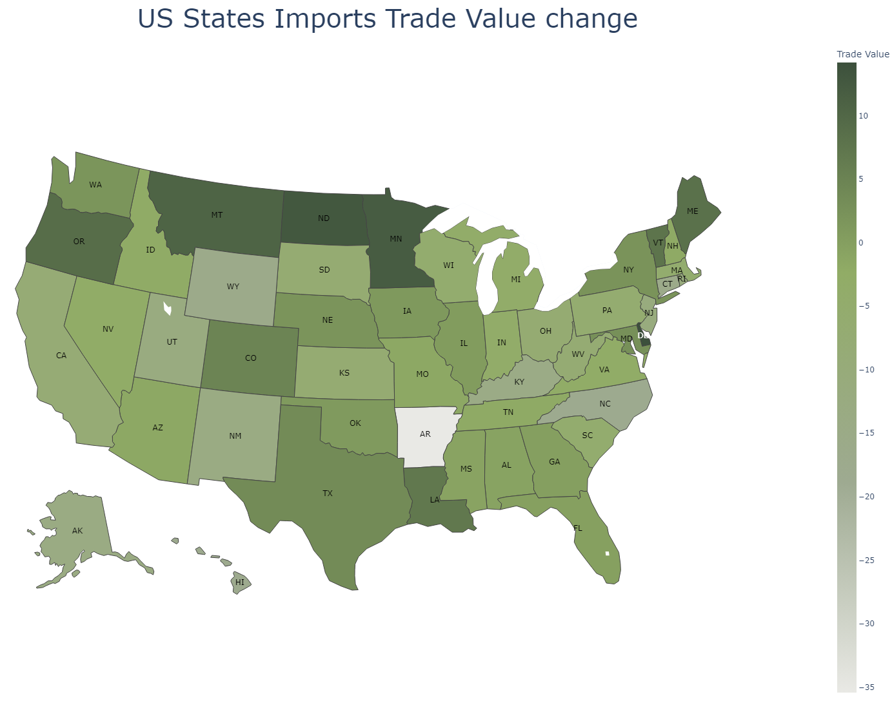
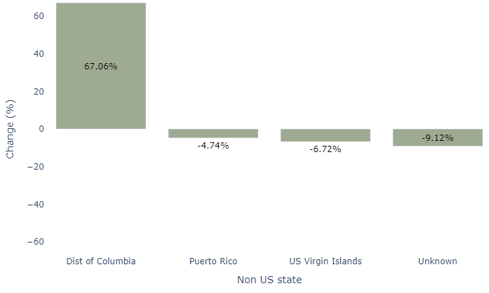
How does the total export and import change by different State from 2021-2022?

Slide 3
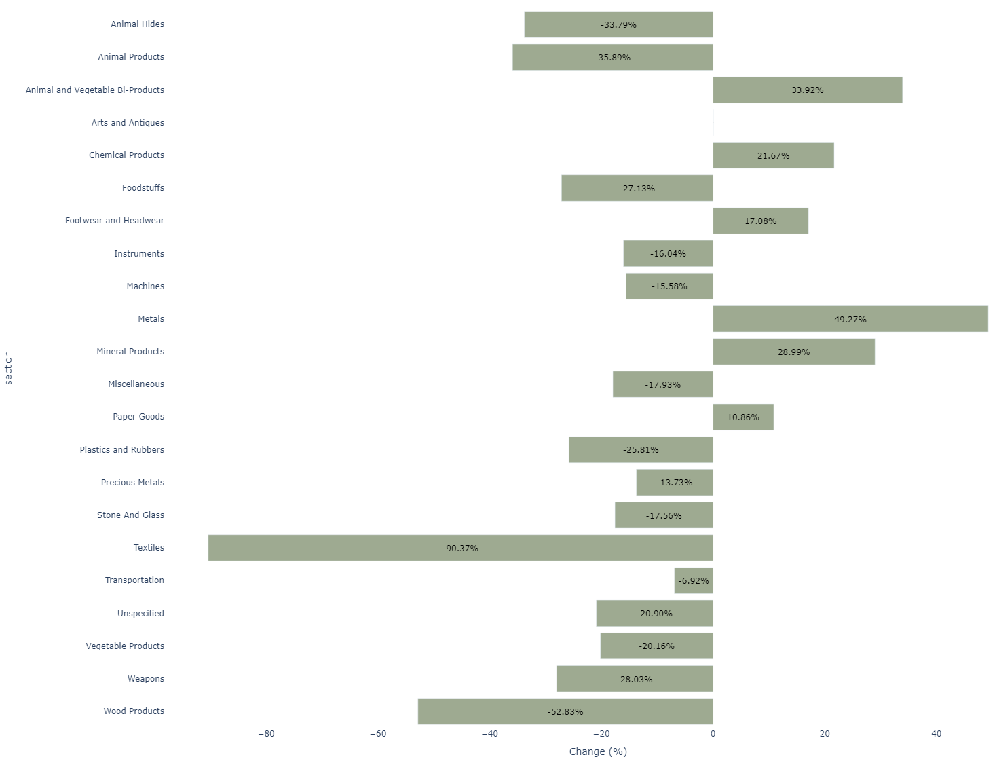
How does the total imports change by HS2 level products in US from 2021-2022?

Slide 4
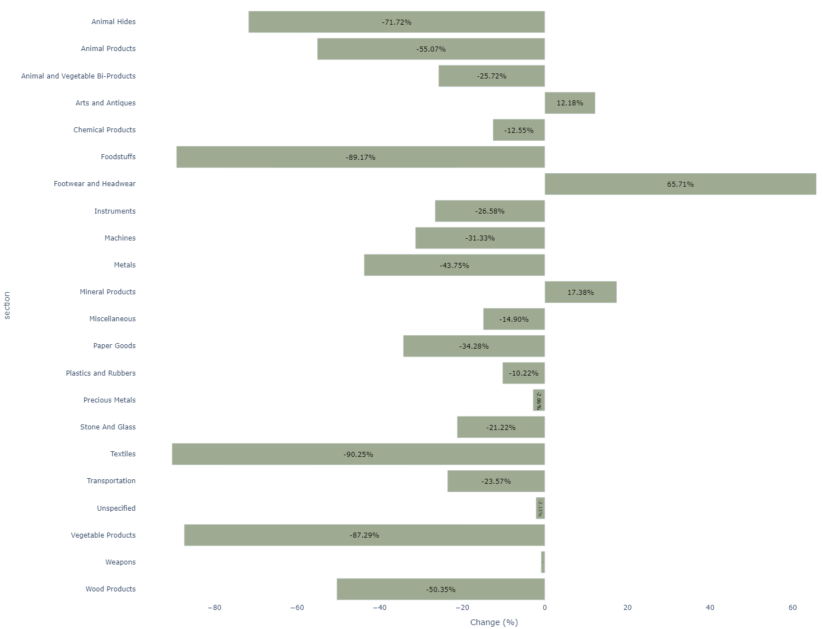
How does the total exports change by HS2 level products in US from 2021-2022?

Slide 5
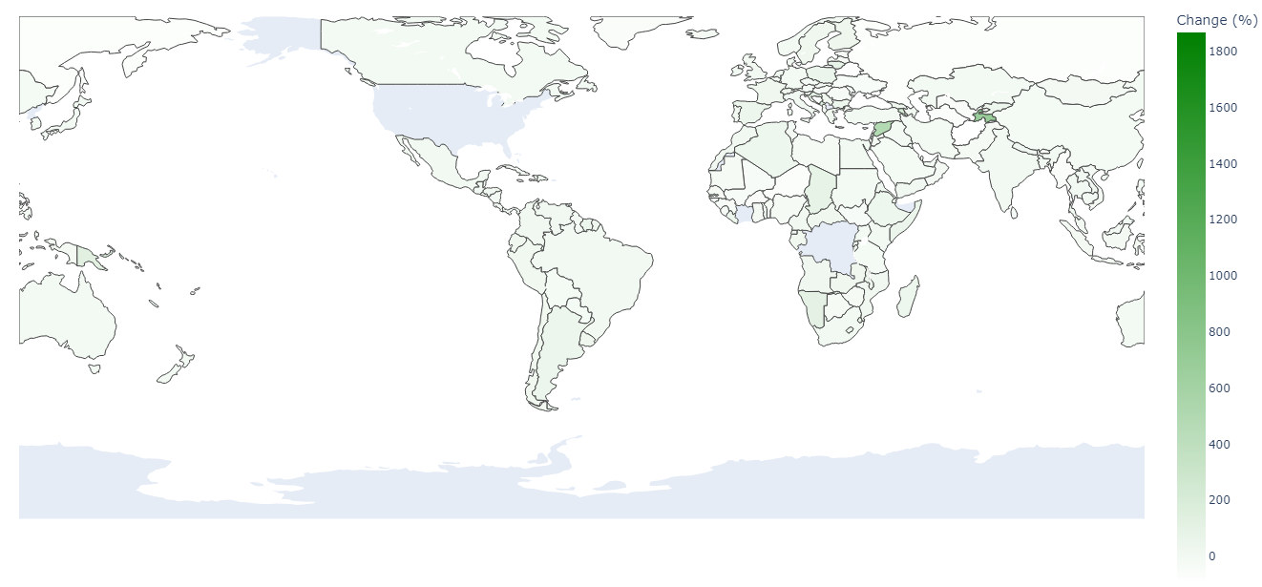
What are the top 10 partner countries for import and export in 2022 and how its share (as part of total import and export value) changed YoY

Slide 6
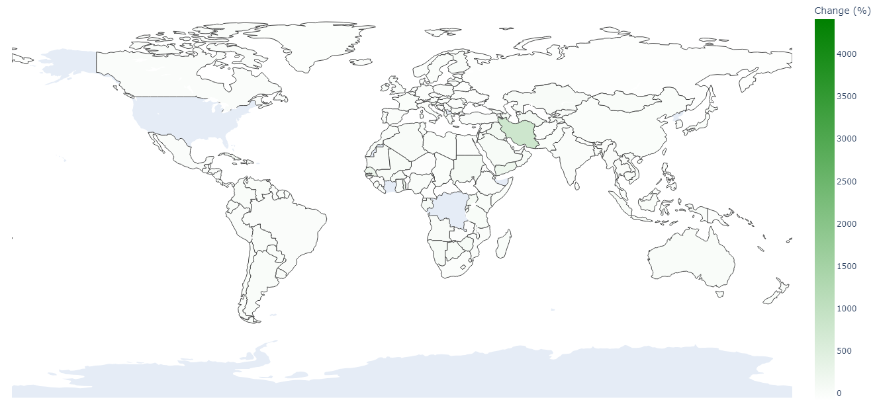
What are the top 10 partner countries for import and export in 2022 and how its share (as part of total import and export value) changed YoY

